Slide 1



PYTHON AND
DATA SCIENCE
hannah deen

Slide 2
TODAY’S AGENDA
Why Python?
But what can you do with it?
Data science!
Working examples.
Q&A

Slide 3
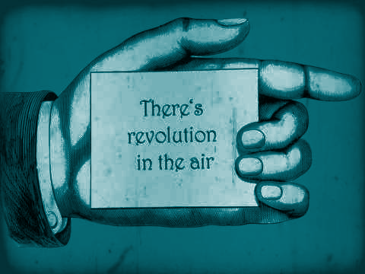
WHY PYTHON??
READABILITY
POPULARITY
GENERALISABILITY

Slide 4
READABILITY
One statement per line.
Tabulation.
Intuitive.
Of course, it’s also your responsibility to keep your code readable..

Slide 5
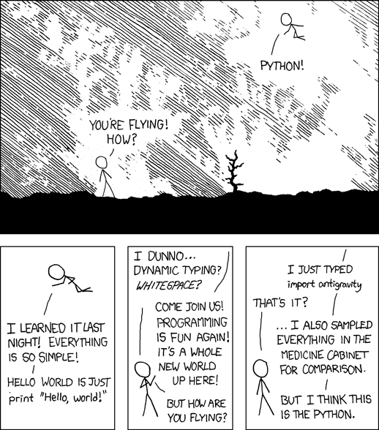

Slide 6

POPULARITY
Because Google and StackOverflow are your number one friends as a computer person, the network of people contributing to a language is hugely important to it’s success.
Lots of people use it, bigger support network, more people use it.

Slide 7
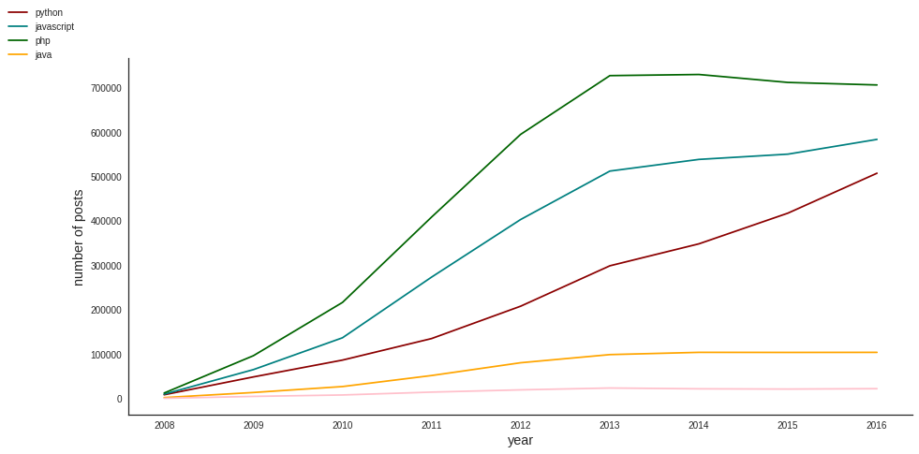
POPULARITY
Stackoverflow posts: public Google BigQuery dataset

Slide 8





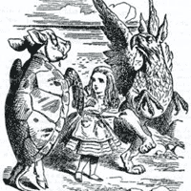



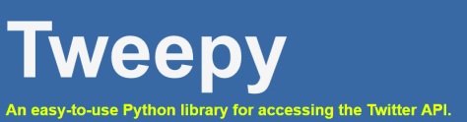

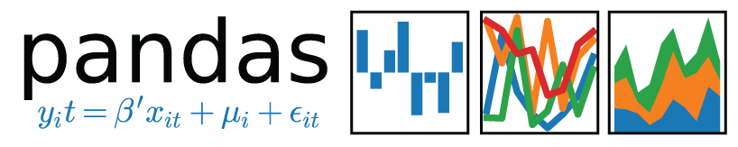
GENERALISABILITY
101610

Slide 9

DATA SCIENCE
“data science democratises
scientific discovery”

Slide 10
PUBLIC CONTRIBUTIONS..
Kaggle.com
Datadriven.org

Slide 11


LET’S GET STARTED

Slide 12
PYTHON, TEXT EDITOR, TERMINAL
INSTALL PYTHON (3.X)
SETUP ENVIRONMENT - INSTALL DEPENDENCIES
WRITE PYTHON SCRIPT (Sublime Text)
RUN SCRIPT

Slide 13
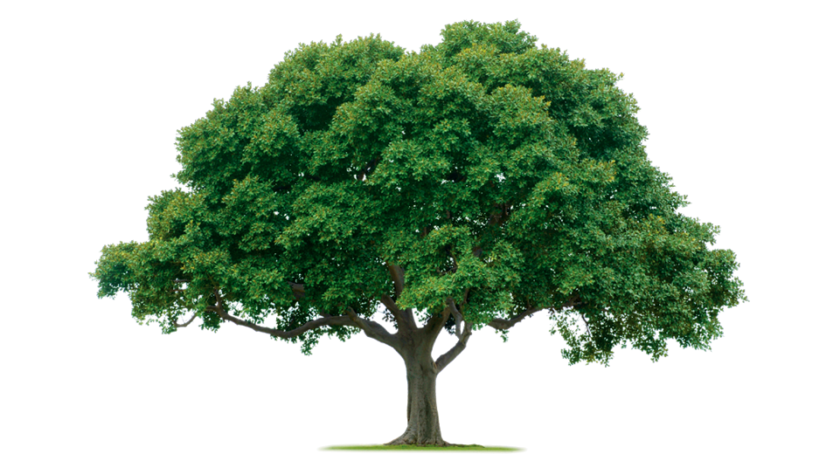
MACHINE LEARNING WITH TREES

Slide 14

READING THE PEOPLE

Slide 15
questions?

